Slide 1
Volley for a cure game
Walnut vs Anderson
By Mackenzie Canto ‘17

Slide 2
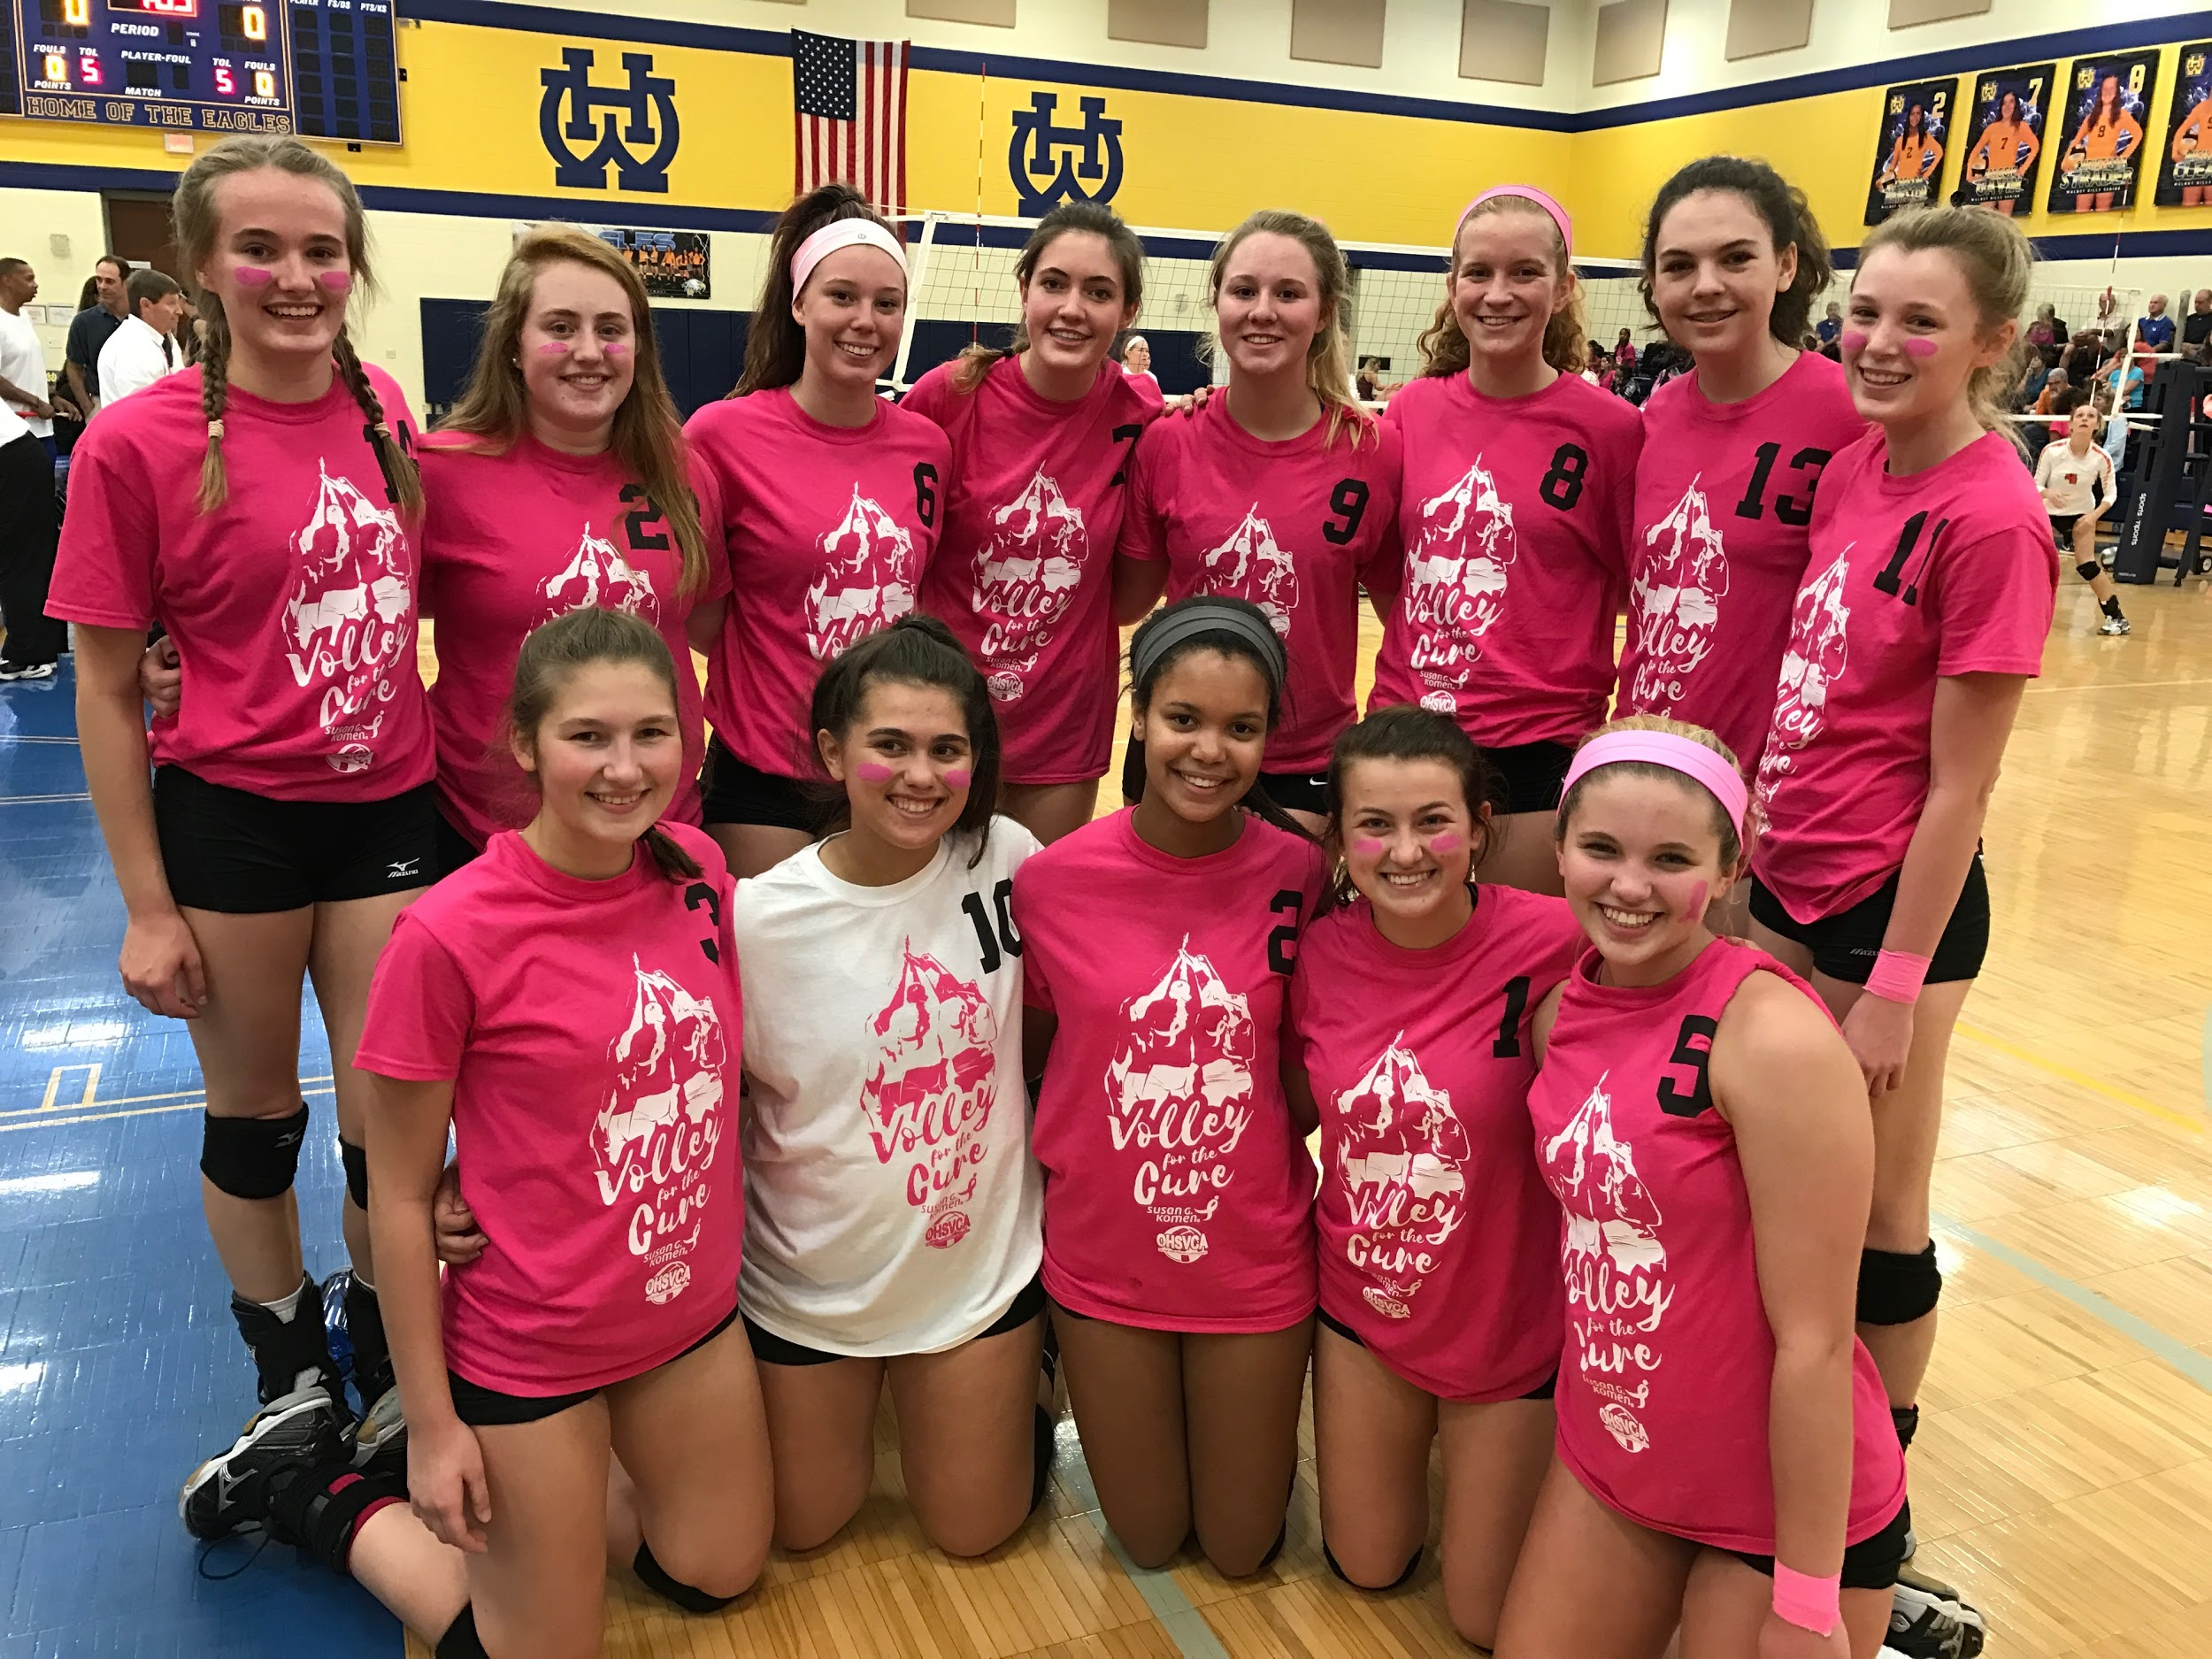
Varsity players pose for a team picture before game, wearing all pink to show support for the cure for Breast Cancer

Slide 3
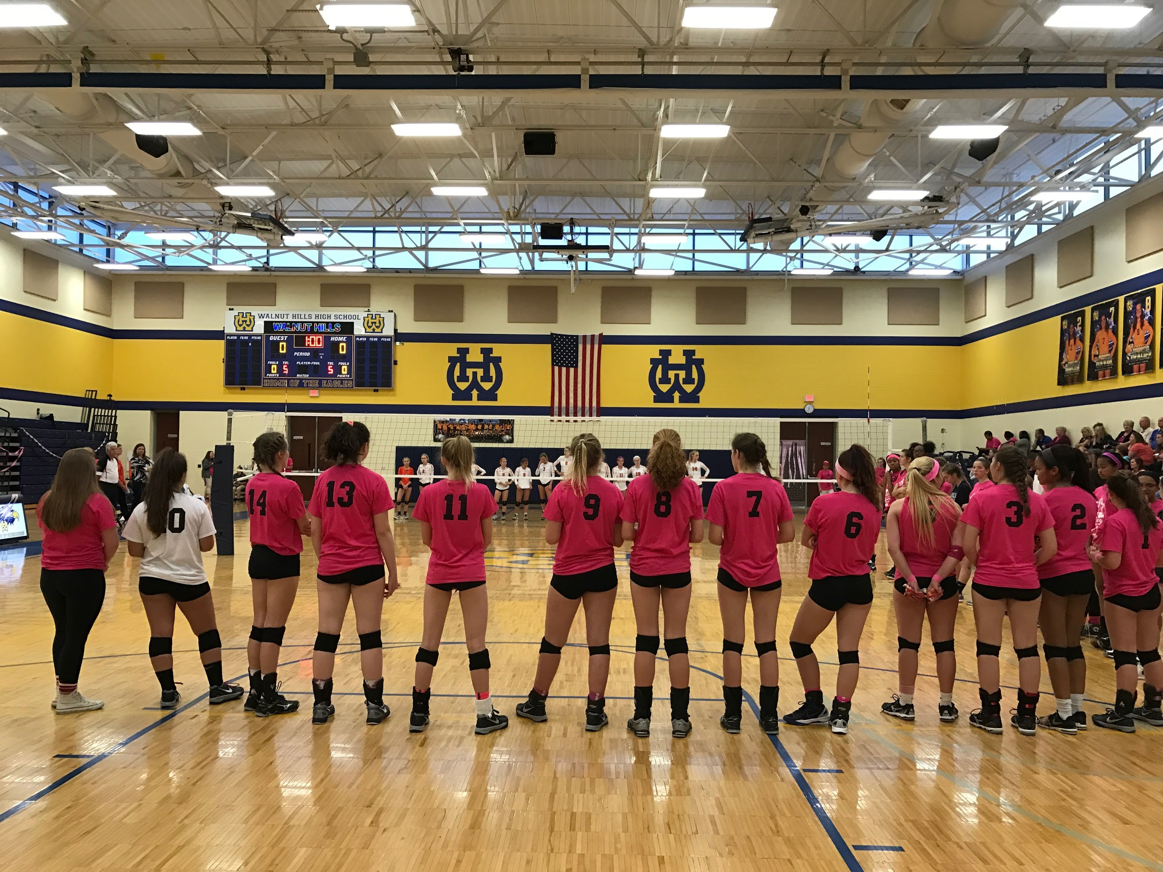
Players line up for the National Anthem

Slide 4
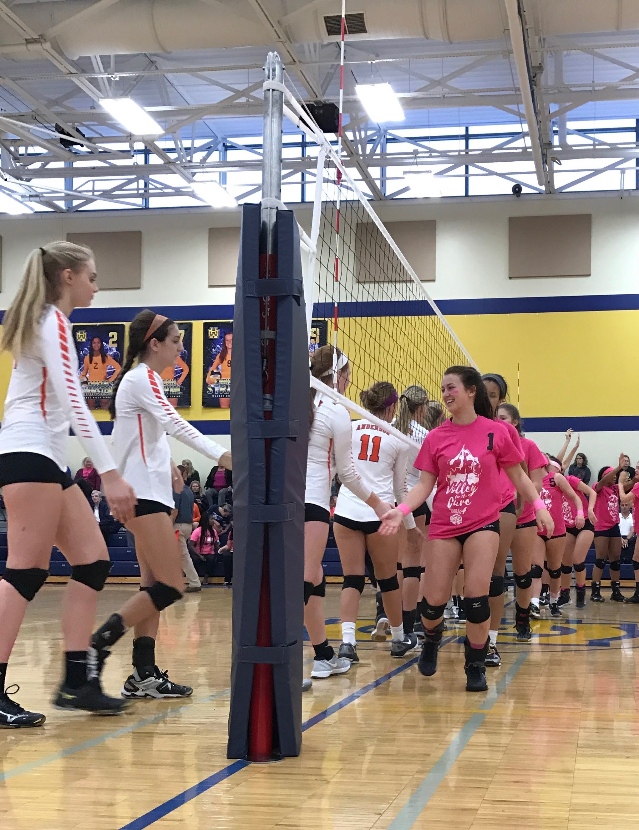
Grace Masur, ‘18 leads the team as they shake hands with the opponent

Slide 5
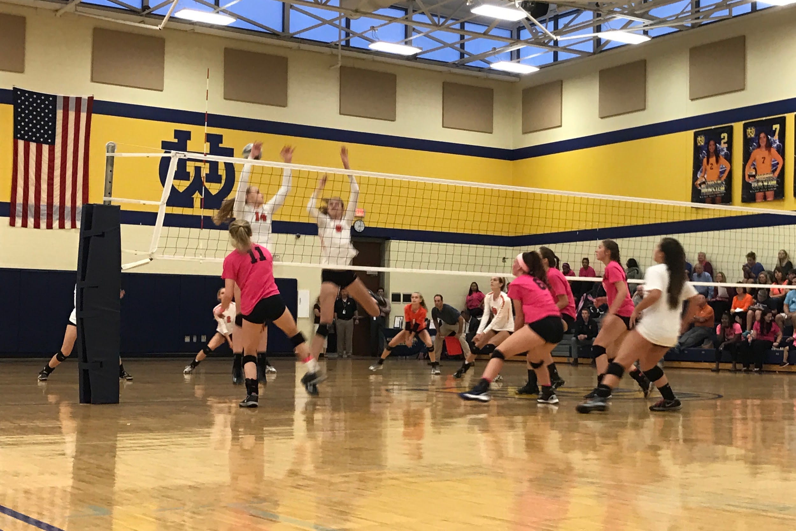
Kaila Clear, SENIOR spikes the ball out of Anderson's reach

Slide 6
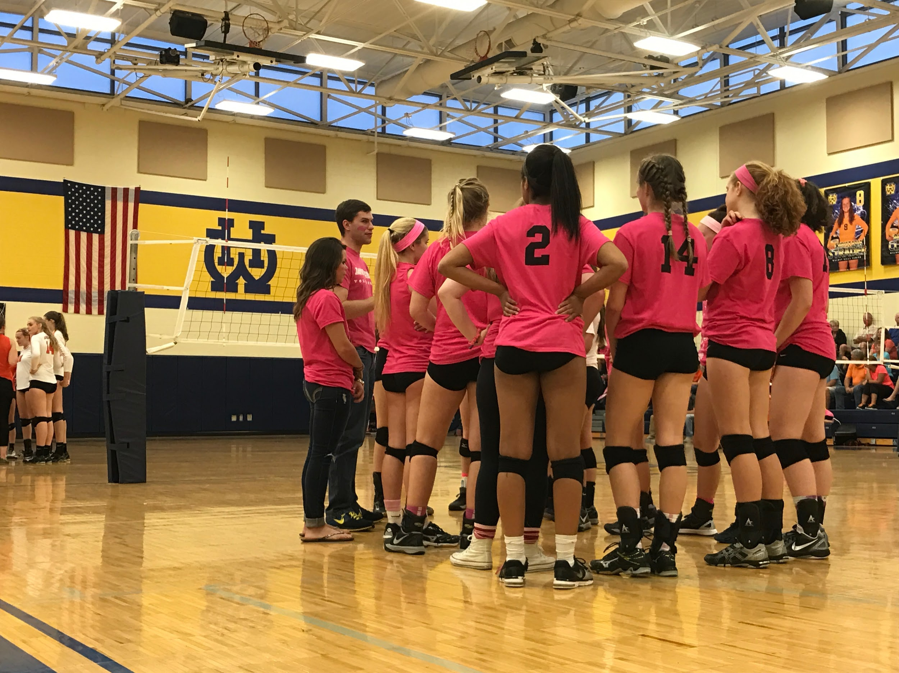
Players huddle up during a time out, listening to the encouraging words of
head coach Nick Toth

Slide 7
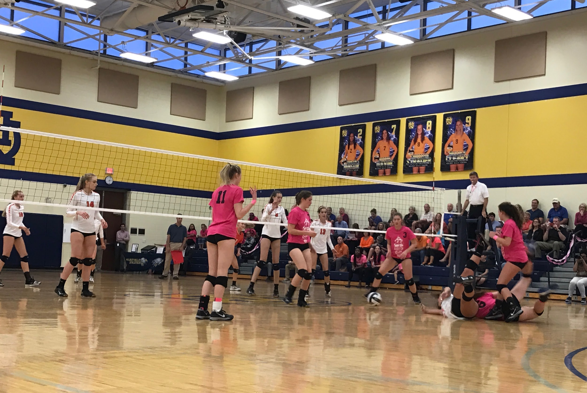
Megan McCreary, ‘18 and Alexis Konstis, ‘18 dive to try and save a ball from hitting the ground

Slide 8
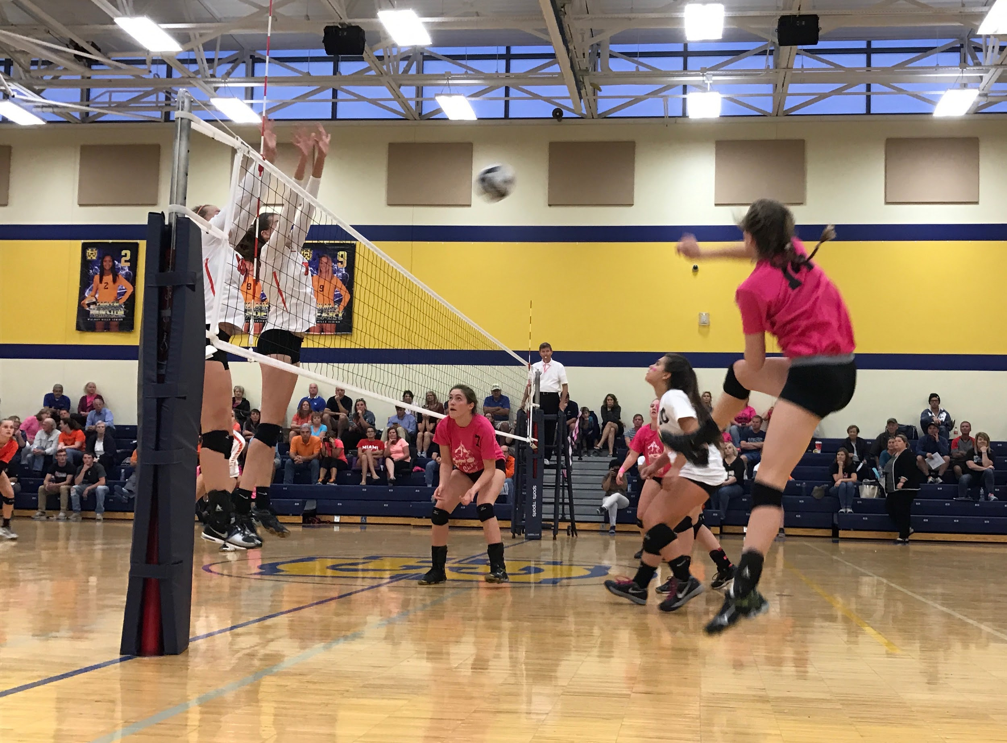
Olivia Tombragel, ‘20 jumping in the air as she spikes the ball onto Anderson's side of the court

Slide 9
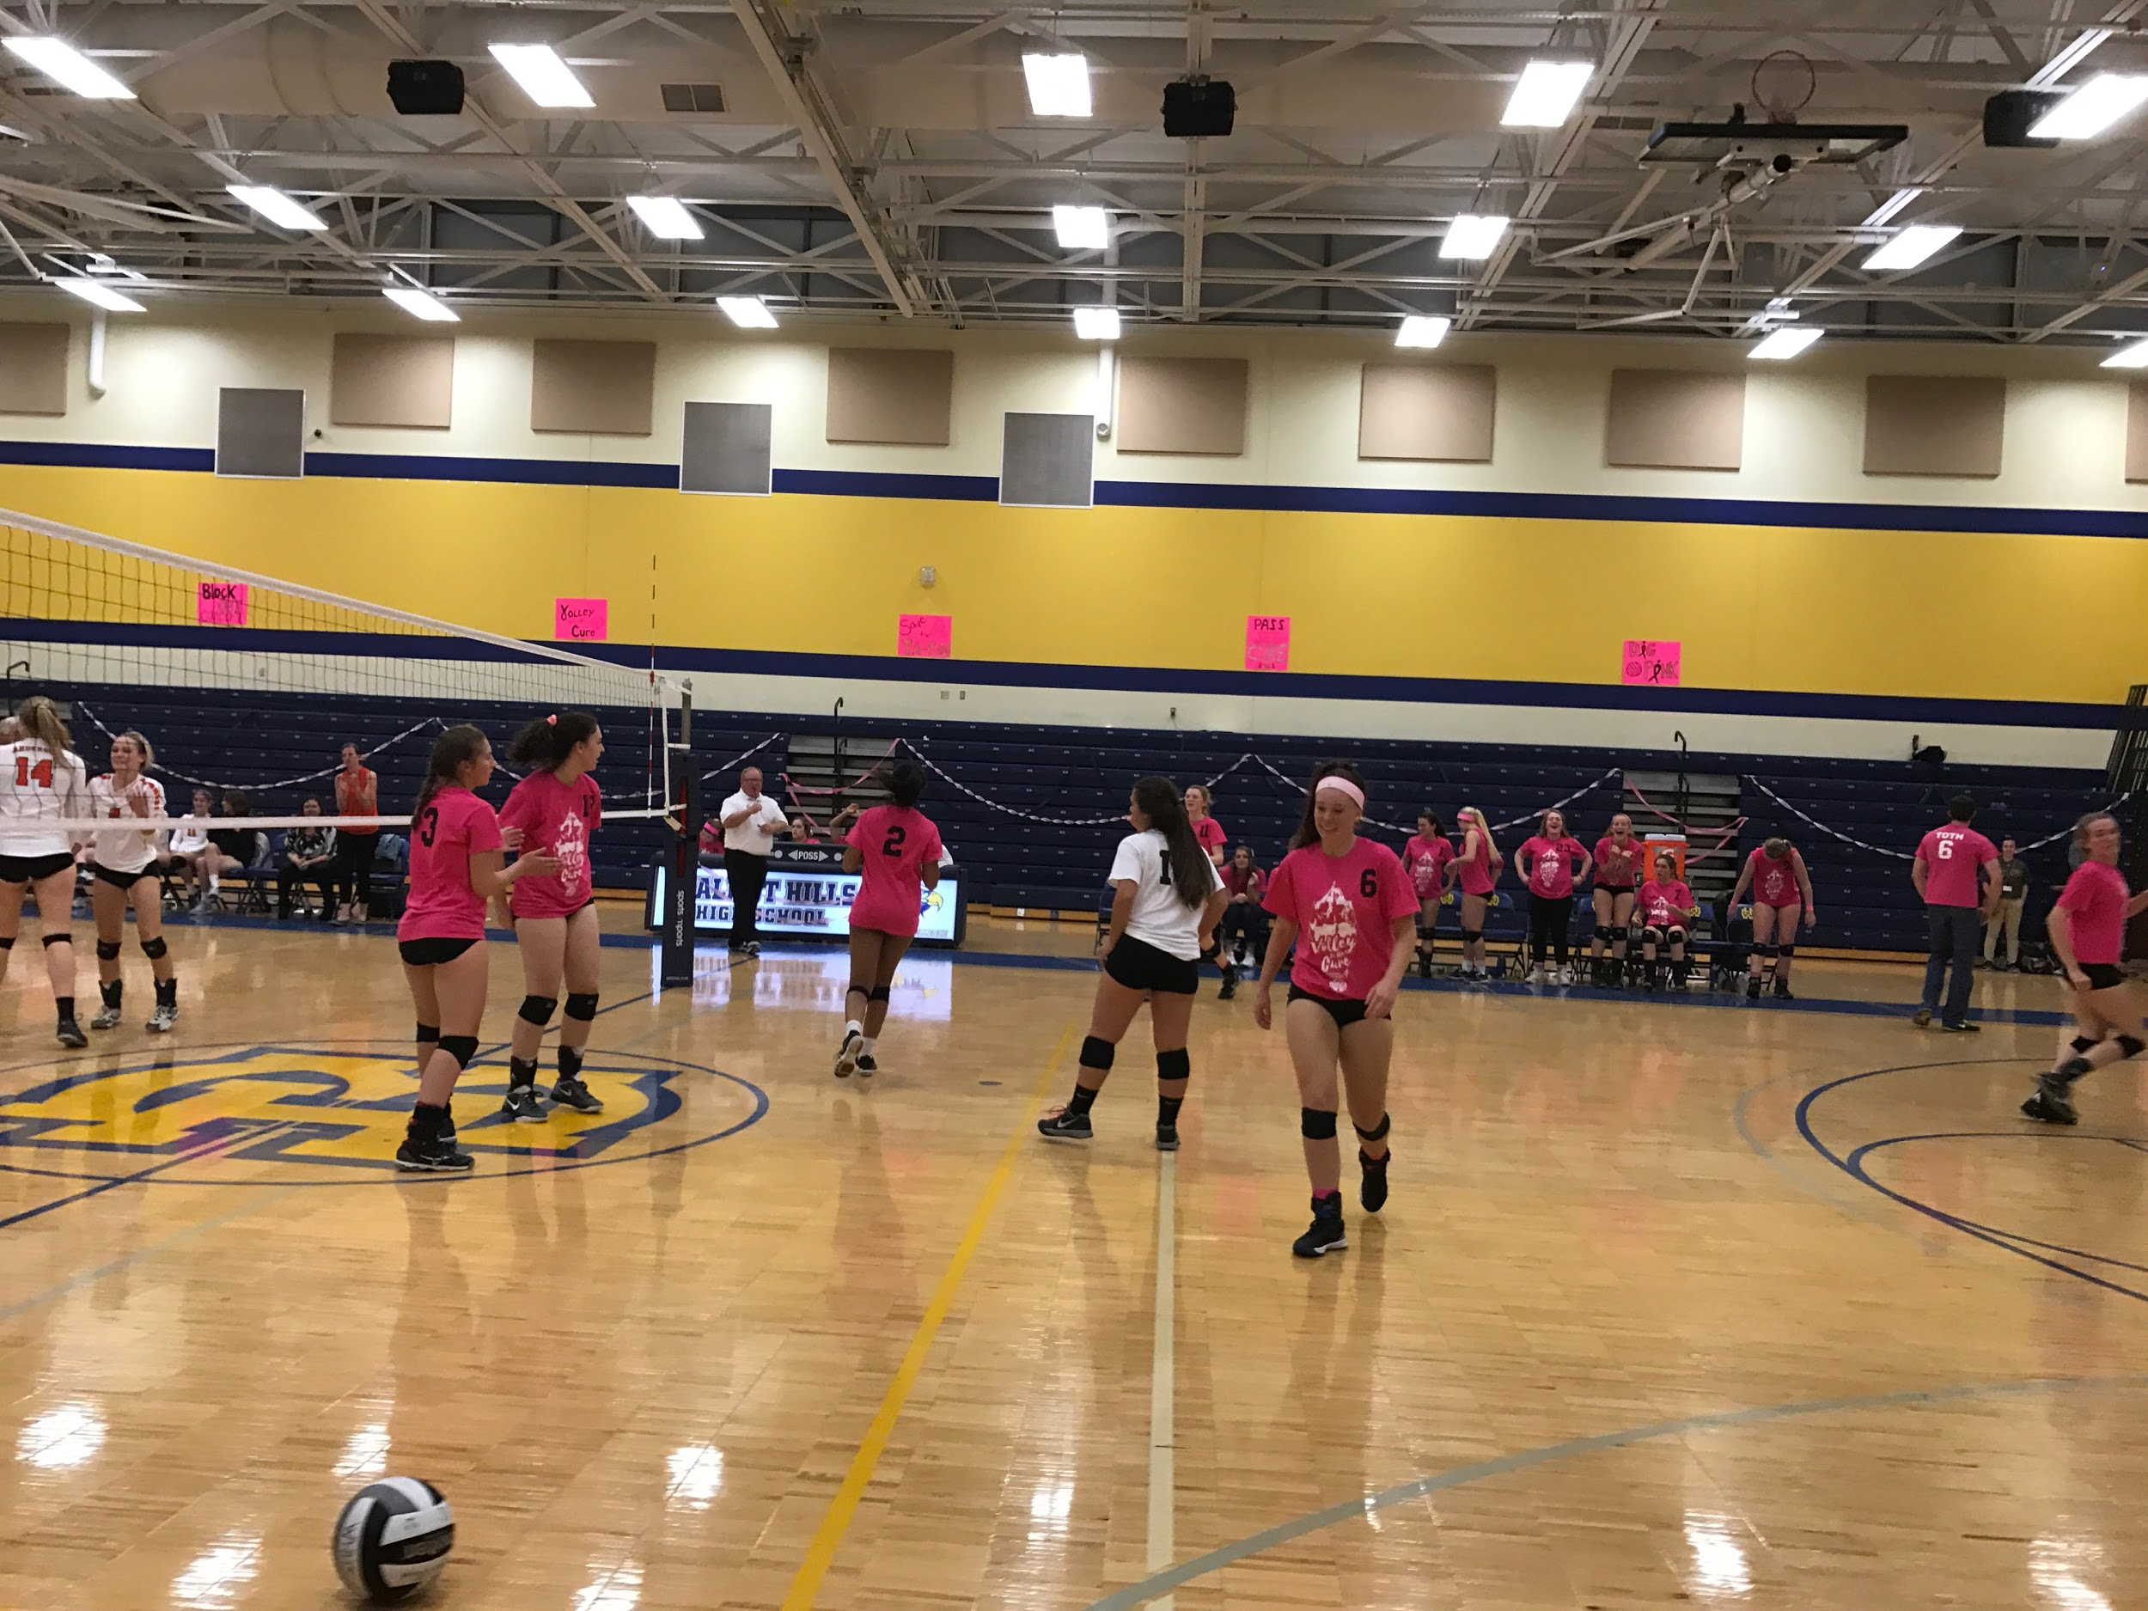
Players walk to positions after a fire play resulting in a point for Walnut

Slide 10
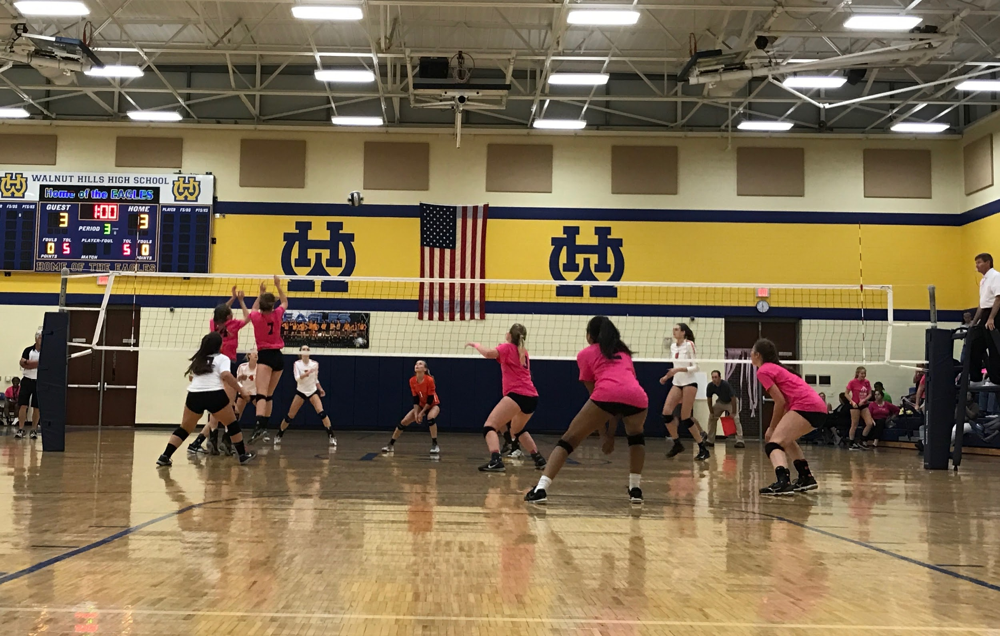
Maggie Gavin, SENIOR and Tombragel, ‘20 jump to block a spike made my Anderson

